Slide 1

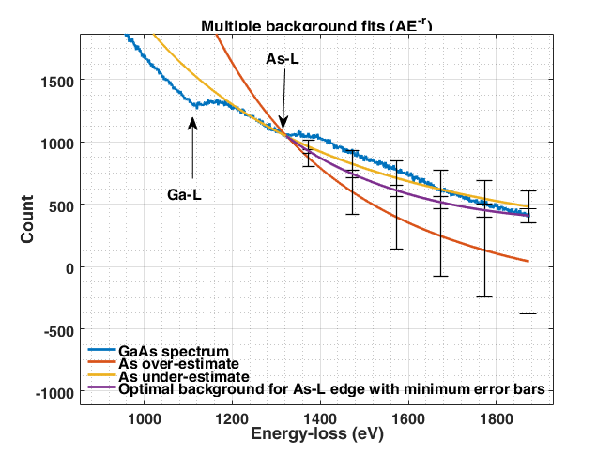
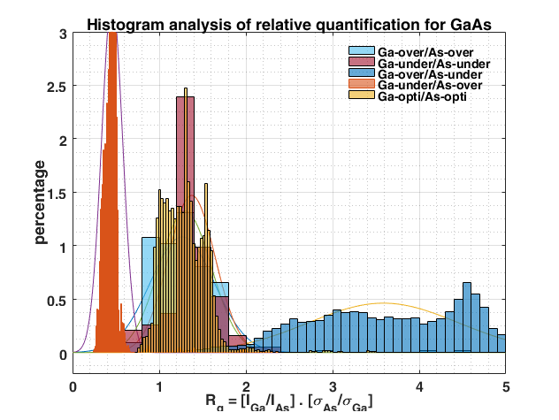
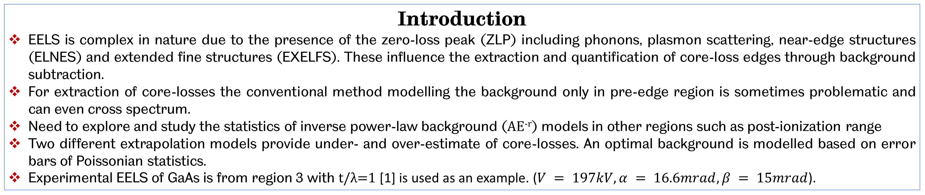
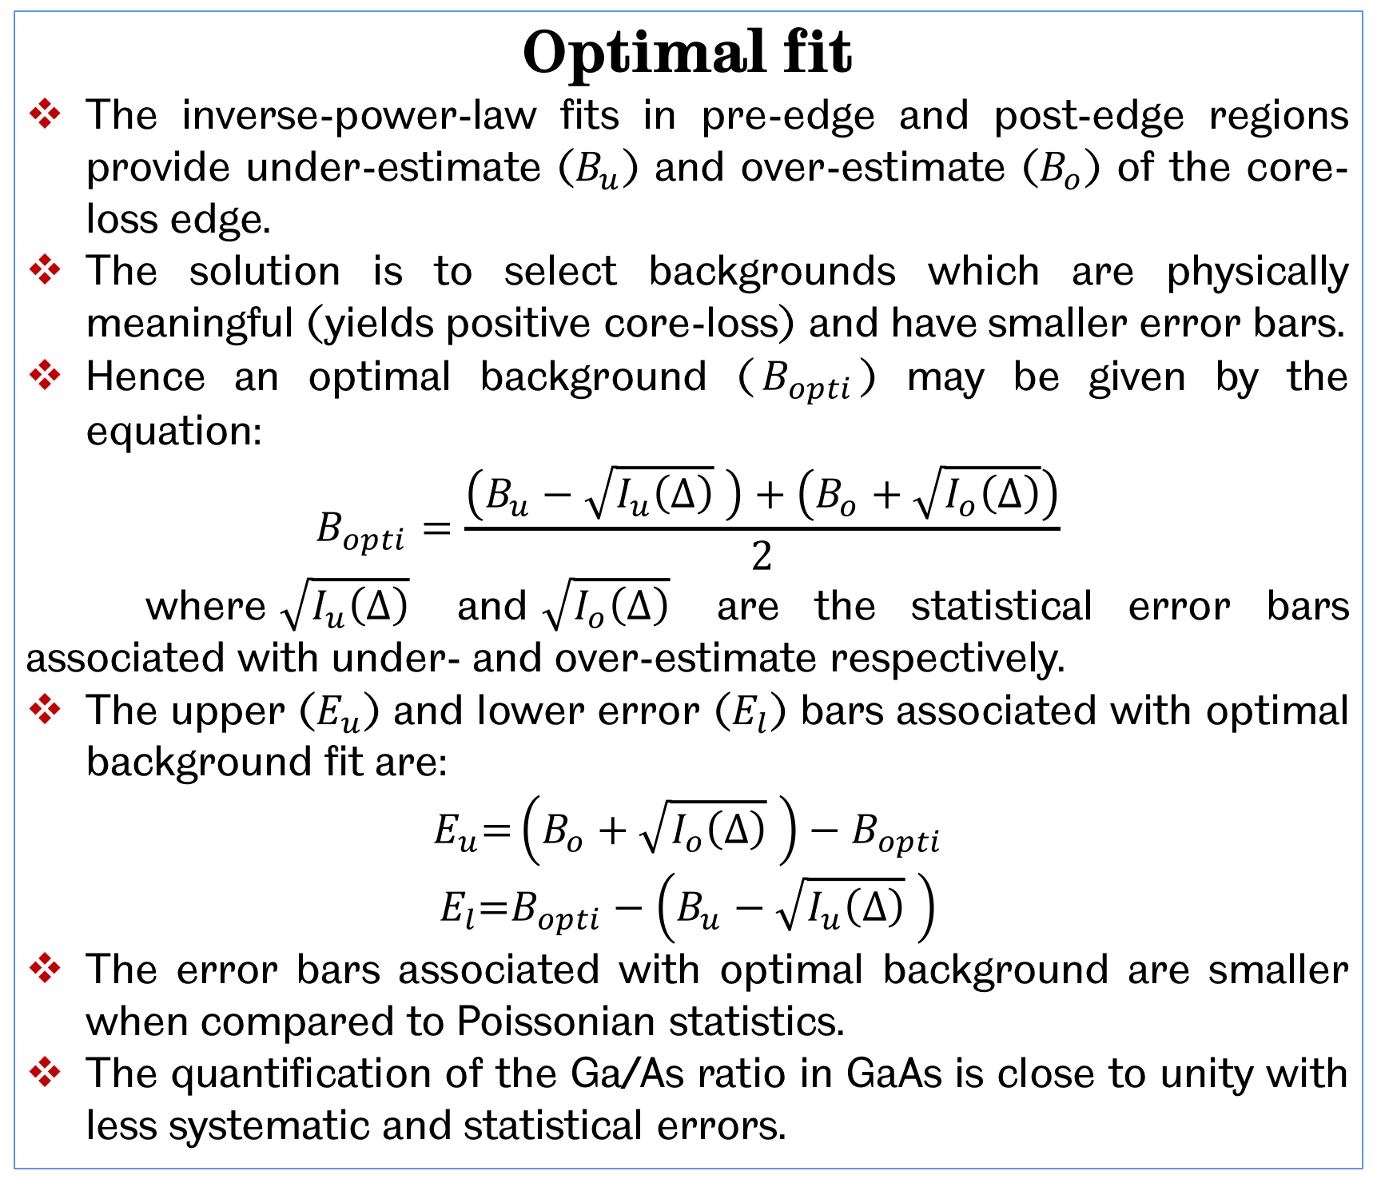
Systematic Study of Background Subtraction Techniques for EELS
Veerendra C Angadi* and Thomas Walther
Dept of Electronic and Electrical Engineering, University of Sheffield, UK
*email: VCAngadi1@sheffield.ac.uk
Introduction
EELS is complex in nature due to the presence of the zero-loss peak (ZLP) including phonons, plasmon scattering, near-edge structures (ELNES) and extended fine structures (EXELFS). These influence the extraction and quantification of core-loss edges through background subtraction.
For extraction of core-losses the conventional method modelling the background only in pre-edge region is sometimes problematic and can even cross spectrum.
Need to explore and study the statistics of inverse power-law background (AE^{-r}) models in other regions such as post-ionization range
Two different extrapolation models provide under- and over-estimate of core-losses. An optimal background is modelled based on error bars of Poissonian statistics.
Experimental EELS of GaAs is from region 3 with t/λ=1 [1] is used as an example. ($V = 197kV, α = 16.6mrad, β = 15mrad$).
Background Models
Pre-edge region
Inverse power-law fits are modelled in the pre-edge region (range >30eV).
For As-L edge even though the R² values are in good agreement, the modelled background is crossing the spectrum as shown in figure 1, due to preceding Ga-L edge.
Background crossing the spectrum predicts a negative core-loss, which is unphysical.
As-L edge can still be quantified by integrating only the positive core-loss range.
The Ga-L edge is straight forward as the it has very large pre-edge region.
The background fits in pre-edge region are highly associated with large systematic errors if the integration ranges are large.
Systematic errors are difficult to identify by regression and quantification.
In figure 2, even though the background is crossing the spectrum, the Ga/As ratio is still close to unity.
Post-edge region
Inverse power-law fits are extrapolated in the post-edge range from end of the spectrum and offset vertically to cross through the edge onset.
With post-edge background modelling, As-L edges have very large apparent cross sections as shown in figure 1.
This indicates an over-estimate of the core-loss edge.
The Poissonian statistical error bars are very large.
The Ga-L edge is not straight forward as it has very small post-edge region with varying gradient compared to pre-edge region.
To extrapolate post-edge inverse power-law of Ga-L edge from end of the spectrum, As-L edge has to be subtracted from the spectrum.
The background fit in post-edge regions are highly associated with statistical errors if the integration ranges are small.
Statistical errors are difficult to identify in R² and quantification.
In figure 2, even though the background is over-estimate the core-losses Ga/As ratio is still close to unity.
Optimal fit
The inverse-power-law fits in pre-edge and post-edge regions provide under-estimate ($B_{u}$) and over-estimate ($B_{o}$) of the core-loss edge.
The solution is to select backgrounds which are physically meaningful (yields positive core-loss) and have smaller error bars.
Hence an optimal background ($B_{opti}$) may be given by the equation:
$$B_{opti}=\frac{\left(B_{u}−\sqrt{I_{u}\left(∆\right)} \right)+\left(B_{o}+\sqrt{I_{o}\left(∆\right)}\right)}{2}$$
where$\sqrt{I_{u}\left(∆\right)}$ and$\sqrt{I_{o}\left(∆\right)}$ are the statistical error bars associated with under- and over-estimate respectively.
The upper ($E_{u}$) and lower error ($E_{l}$) bars associated with optimal background fit are:
$$E_{u}\text{=}\left(B_{o}+\sqrt{I_{o}\left(∆\right)} \right)−B_{opti}$$
$$E_{l}\text{=}B_{opti}−\left(B_{u}−\sqrt{I_{u}\left(∆\right)} \right)$$
The error bars associated with optimal background are smaller when compared to Poissonian statistics.
The quantification of the Ga/As ratio in GaAs is close to unity with less systematic and statistical errors.
Fig 1: Experimental EELS of GaAs with t/λ=1 with different background fits with error bars for As-L (Ga-L is more straight forward).
Fig 2: Normalized histograms of Ga/As quantification from all possible background subtraction routines. The combination of optimal background fitting yields $µ = 1.2759 σ = 0.2703$
Conclusion
Improvements in R² values do not guarantee more accurate quantification.
The optimal background modelling provides quantification values with error bars below counting statistics.
The optimal background can be used to extract core-losses from spectrum and the underlying core-losses can be quantified with better statistics using larger integration ranges (∆) [2,3].
References
[1] V. C. Angadi, C. Abhayaratne, T. Walther. (2016), J. Microscopy, in print, doi:10.1111/jmi.12397.
[2] R. F. Egerton, Electron energy-loss spectroscopy in the electron microscope. Springer, 1996, vol. 233.
[3] Digital Micrograph. [Online]. Available: http://www.gatan.com/

